Slide 1
Project Name: Smart Home Energy Consumption Analysis using PySpark Big Data Analytics Lab-B22EF0505
Presented By :
Manasa KM (R23EH063)
Lab handling Mentor Name:
Dr. Sheelavathy KV
Dr. Ajil A
Dr. Syed Muzamil Pasha
Sem:5th / Section: B

Slide 2
Table Of Contents
01
Abstract
02
Introduction
03
Objectives
04
Literature Review
05
06
Results and Discussions
Methodology
07
Conclusions
08
References

Slide 3
Abstract
Smart homes generate large volumes of time-stamped energy consumption data from sensors and appliances. This project uses PySpark to process, clean, and analyze big smart-home datasets and to build predictive models for household energy consumption.
Key contributions include:
Large-scale data preprocessing and feature engineering
Hourly, monthly, and seasonal energy consumption analysis
Regression models (Linear Regression & Random Forest) for forecasting
Visual analytics including time-series plots, scatter plots, and correlation maps
Evaluation using RMSE, MAE, and R² metrics
Random Forest outperformed Linear Regression, showing the importance of non-linear modeling for complex IoT energy data.

Slide 4

Introduction
Smart homes use sensors and smart meters to capture continuous data about household electricity usage. These large datasets require big-data tools like PySpark for efficient processing. Analyzing such data provides insights into:
High-consumption appliances
Peak usage hours
Seasonal influence on consumption
Environmental dependencies such as temperature
This project builds a full analytics pipeline to uncover patterns and develop predictive models aiding efficient energy distribution and conservation.
Highlight Button

Slide 5
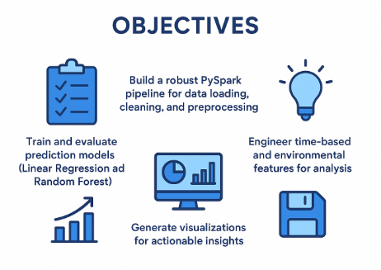
Objectives
Build a robust PySpark pipeline for data loading,cleaning etc.
Engineer time based and environmental features for analysis
01
02
03
Train and evaluate prediction models
04
Generate visualizations for actionable insights

Slide 6
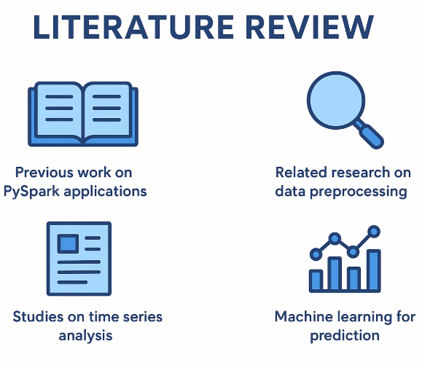
Literature Review
Big Data in Energy Analytics
Energy Forecasting Models
Spark & Hadoop are widely used for processing large sensor datasets due to scalability and computation.
Tree-based models like Linear Regression, Random Forest etc perform best for non linear electricity patterns.
Feature Engineering for Energy Data
Real time Smart Grid Analytics
Time features, temperature, humidity, and household characteristics significantly improve prediction accuracy
Research highlights PySpark’s role in enabling streaming pipelines and real-time monitoring of smart homes.

Slide 7
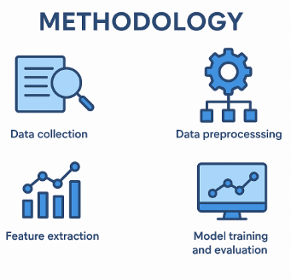
Methodology
Data loading & Schema Detection
Data Cleaning
Auto-detected timestamp and numeric fields
Schema inferred using Spark
Remove nulls
Converted timestamp fields
Cast energy usage to proper types
Missing Value Treatment
Modeling
Numerical columns filled using median imputation
Linear Regression(baseline)
Random Forest(100 trees, max depth 8)
Train-test split: 80?20

Slide 8
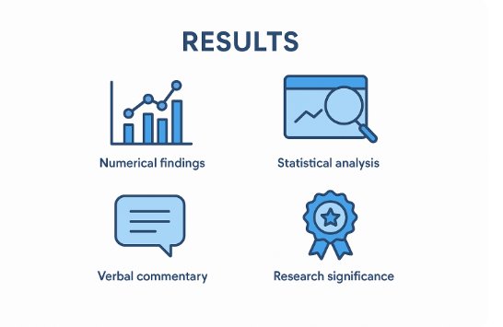
Results and Discussions
Topic 001
1. Exploratory Data Analysis
Energy peaks at 6–9 AM and 6–10 PM
Higher loads seen during summer and winter
Strong correlation between temperature and energy usage

Slide 9
Results and Discussions
Practical Findings
Appliance scheduling can reduce peak loads
Seasonal consumption helps grid planning
Models support real-time energy forecasting in smart homes
Topic 002
Topic 003
3. Feature Importance (Random Forest)
Hour of Day
Outdoor Temperature
Month
Household Size
4. Practical Findings
Appliance scheduling can reduce peak loads
Seasonal consumption helps grid planning
Models support real-time energy forecasting in smart homes

Slide 10
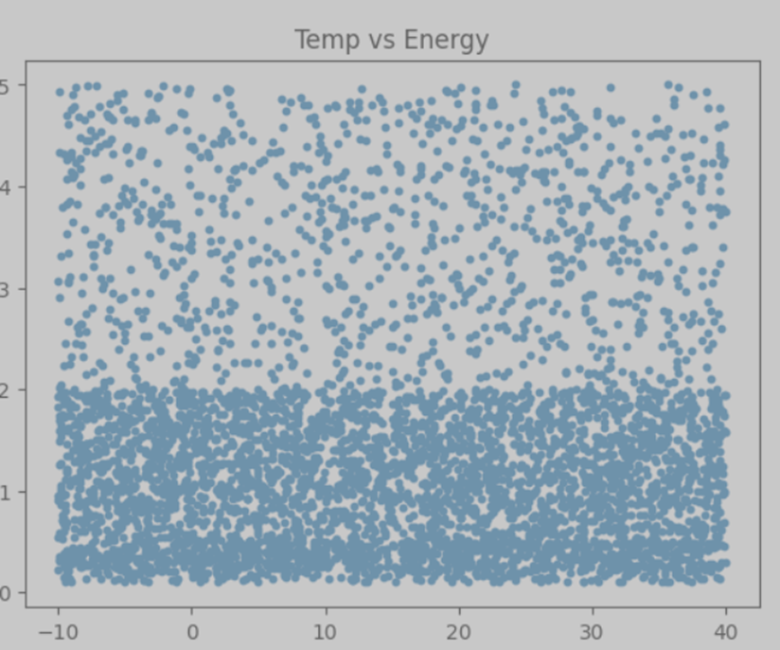
Diagram Data Chart
Temperature vs Energy (Scatter Plot)

Slide 11
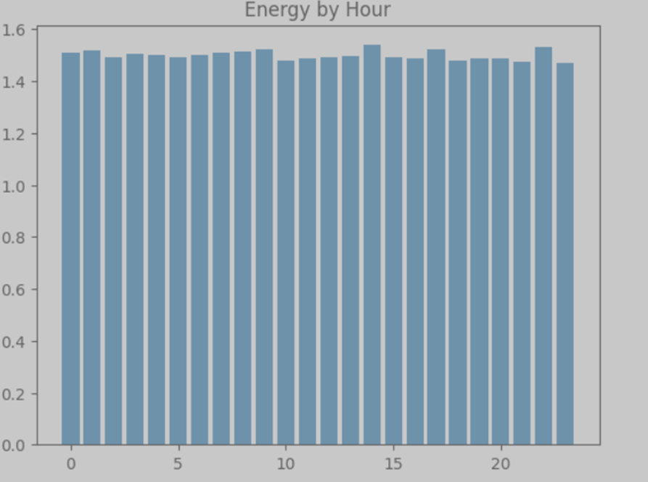
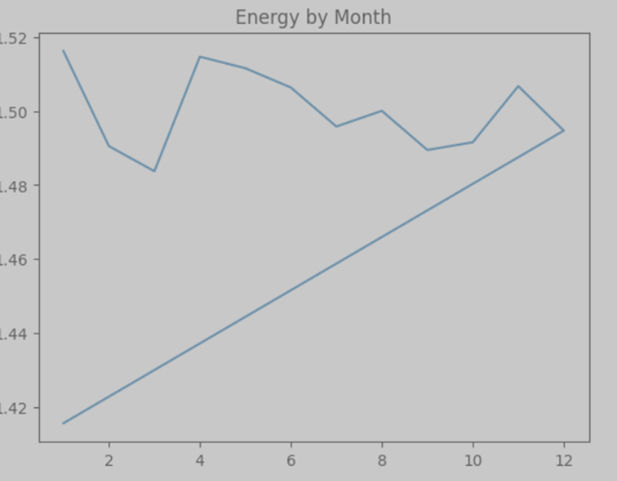
Diagram Data Chart
A.
450K
B.
520K
C.
580K
D.
420K
Energy by Hour (Bar chart)
Energy by Month (Bar chart)

Slide 12
Conclusion
This project successfully implemented a scalable PySpark-based analytics pipeline for smart-home energy consumption.
Future enhancements include integrating lag features, implementing streaming analytics, and using advanced deep learning models.
Findings show:
01
Topic One
03
Topic Three
Clear temporal and environmental patterns in energy usage.
02
Topic Two
Visualizations provide actionable insights for power conservation
Random Forest is highly effective for forecasting

Slide 13
References
PySpark MLlib Documentation
Kaggle – Smart Home Energy Dataset
IEEE Smart Grid Publications
Matplotlib & Pandas Documentation
Apache Spark Documentation
Research articles on Energy Forecasting and Smart Home Analytics
Highlight Button

Slide 14
Thank You

